Slide 1
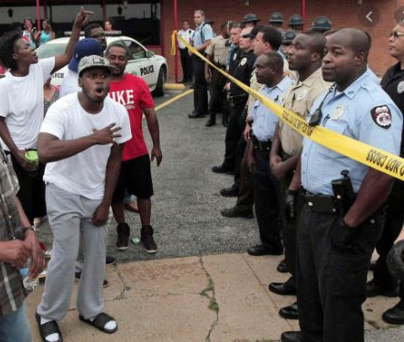
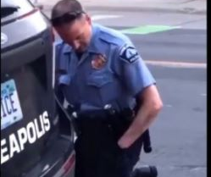
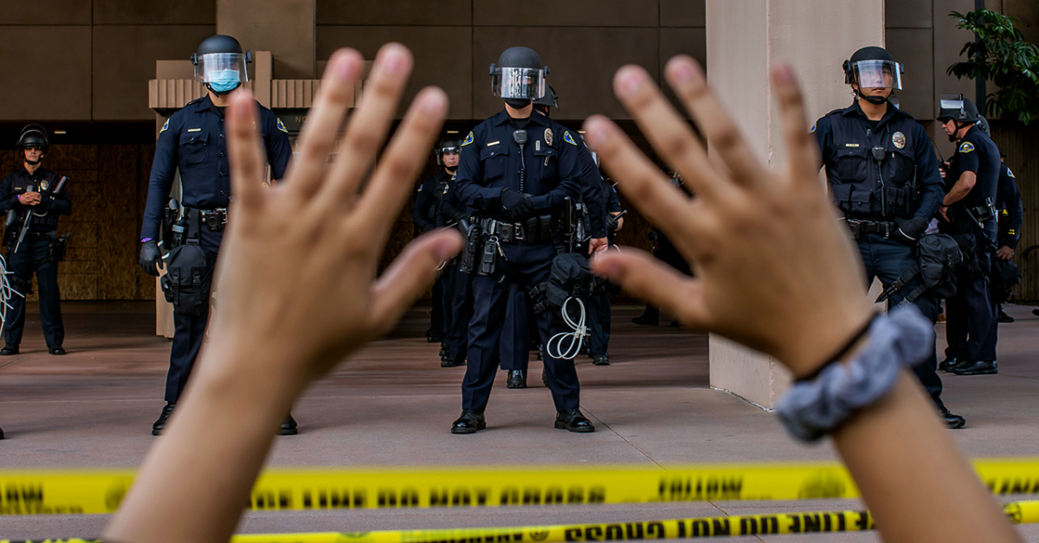
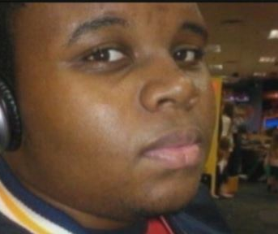
The Reality
“Police violence is a leading cause of death for young men in the United States. Over the life course, about 1 in every 1,000 black men can expect to be killed by police. Risk of being killed by police peaks between the ages of 20 y and 35 y for men and women and for all racial and ethnic groups. Black women and men and American Indian and Alaska Native women and men are significantly more likely than white women and men to be killed by police. Latino men are also more likely to be killed by police than are white men.”
PNAS (Proceedings of the National Academy of Science of the United States of America)

Slide 2
“Why Are Black Men Afraid of the Police”
A New DocuFilm Concept by Emiel Cleaver, an Award-Winning Documentarian
The first experience African Americans had in this country with law enforcement officials came through Slave Patrols in the Antebellum South. Throughout the years the distrust from the black community toward police officers has only grown. “Why Are Black Men Afraid of the Police” will talk about the historical relationship between law enforcement and black men. This project will give first-hand testimonials of black men from all walks of life describing their encounters with the police. "Why Are Black Men Afraid of the Police" will also explain why African Americans believe that black lives don't matter. The mission of this film is to continue the discussion of how we can bridge the gap between the police and the black community.

Slide 3
About SLACO
The St. Louis Association of Community Organizations (SLACO) is a membership-based coalition of neighborhood organizations from across the St. Louis region. SLACO serves as an umbrella organization to engage in networking and education of its member neighborhood associations, action campaigns, and improving the quality of life for residents. Currently the 31 members represent 33% of the population of the City of St. Louis. Membership is open to organizations throughout the metropolitan area.
SLACO serves and is led by neighborhood leaders from across the St. Louis metropolitan area focused on: Neighborhood Capacity Building; Community Empowerment; Neighborhood Advocacy; Communication Networking and Affordable Housing Development.

Slide 4
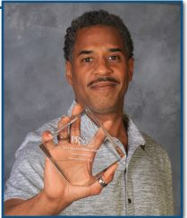
Meet Emiel Cleaver
Emiel Cleaver has more than twenty years of experience in video production. He earned a B.A. in English Literature from Philander Smith College. After graduation, his first employment was as a Production Assistant at Metro Sports/Time Warner in Kansas City, Missouri, where he worked on several sports shows. Emiel also owns his own video production company, Davenport Media & Film, and has promoted concerts, organized special events and has directed and produced several music videos and mini documentaries, ranging from hip hop group Soul Servers to jazz legend Amahad Alaaden. He completed mini videos for the American Jazz Museum’s 10th Anniversary (18th and Vine: More Than Jazz, More Than Baseball) and also for the Robert Frazier Gallery of Contemporary Art for the opening reception and art exhibit as a prelude to the Kansas City Lyric Opera’s John Brown opera. In addition, Emiel has compiled an impressive collection of art photos and music videos. Emiel, who is also a Black History enthusiast and a rap artist, is a graduate of Filmmaking Studies at the University of Kansas City-Missouri/Communications Department, where he earned a Dean's Certificate from the University's Film and Media Arts Department. He wrote and performed a rap song, "Black Is Beautiful." Emiel has worked with and has consulted on various projects with the American Jazz Museum and the Black Archives of Mid-America, where he directed tours and videotaped jazz concerts.

Slide 5
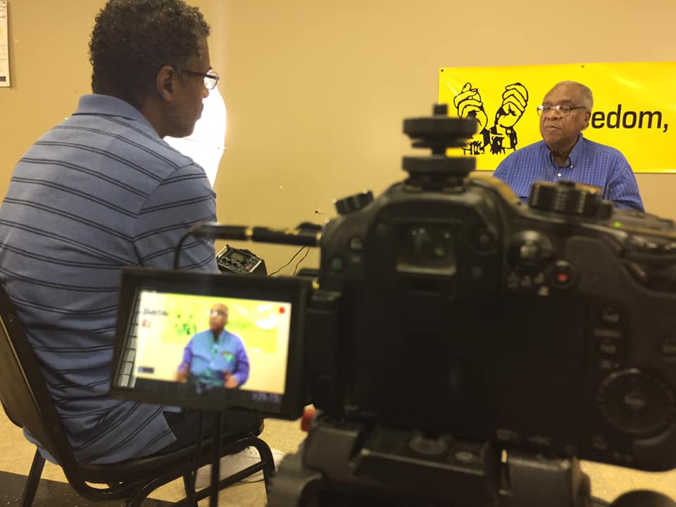
Filmography
“Abolitionist John Brown” (2010)
“Freedom Is Now: The History of Freedom Incorporated“ (2012)
“An Activist for The People” (2012)
“Rooted In Faith-Honoring Our Legacy Renewing Our Commitment 1859-2014“ the History of First Baptist Church in Kansas City, Kansas (2014)
“Legacy of Leadership" (2020)

Slide 6
Production Timetable
The following is the anticipated production schedule for the film (provided funding will keep the project in motion throughout each phase).Description of work start and end dates:
Phase One Pre-Production 2 Weeks
Phase Two Production 16 weeks
Phase Three Postproduction 6 weeks
Phase Four Airing and Distribution

Slide 7
Airing & Distribution
The producers of “Why Are Black Men Afraid of the Police” plan to release the documentary through a streaming app service or on network television February 2022. Due to the recent popularity and success of theatrically released documentaries, Encounters with the Police, will also be considered as a theatrical motion picture release. Additionally, the film will be made available to third parties interested in educational use.

Slide 8
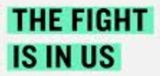
Current or Former Community Partners

Slide 9
Current or Former Community Partners

Slide 10
Past Funders & Partners

Slide 11
Past Funders & Partners

Slide 12
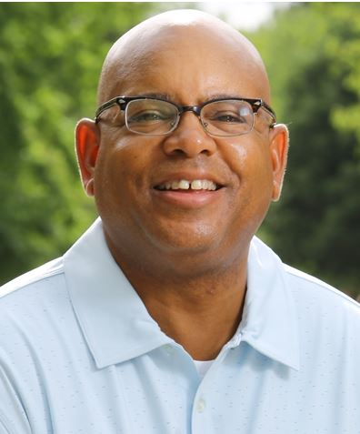
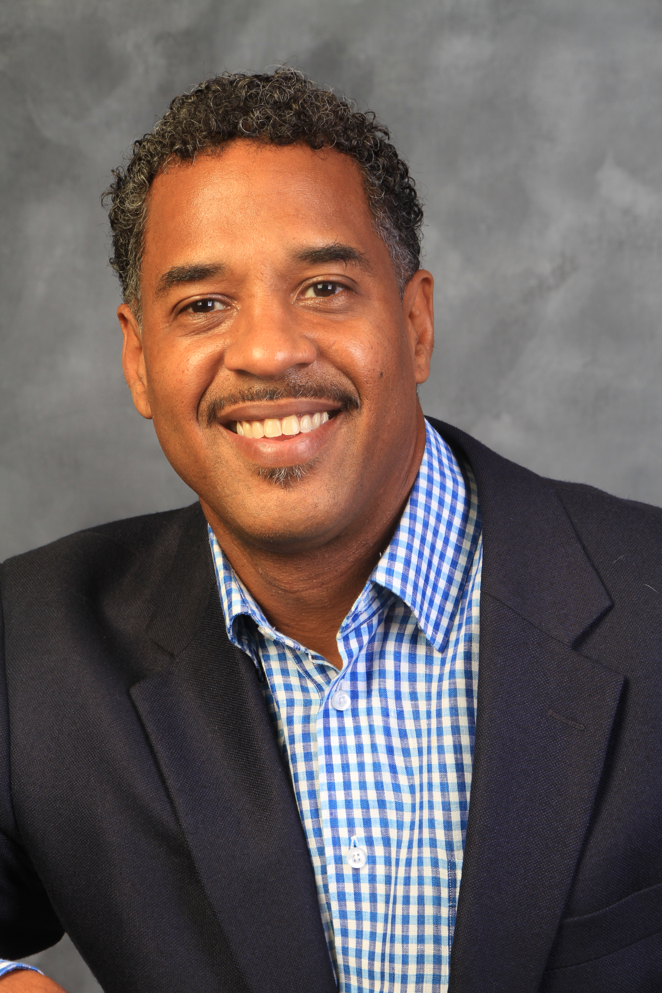
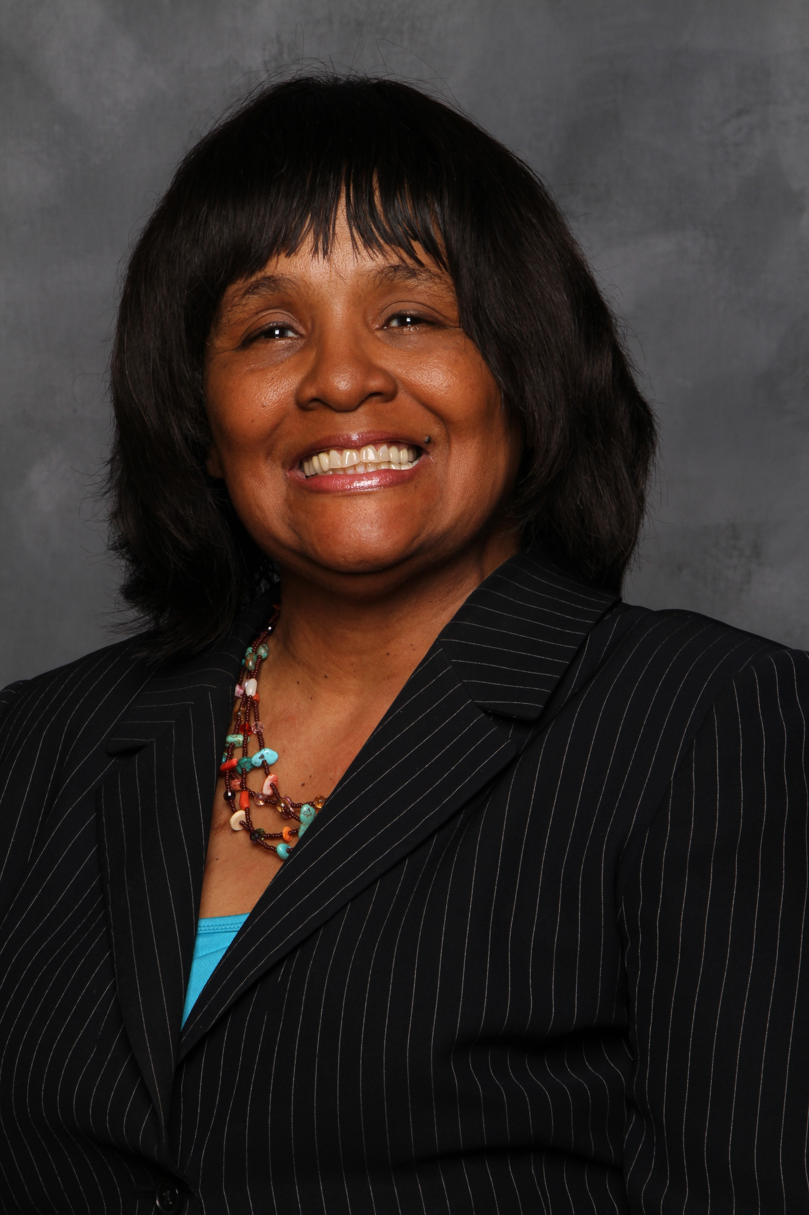
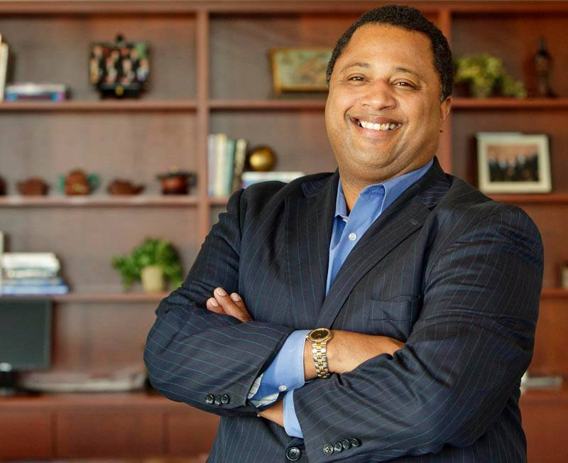
The Team
Carrie Stapleton
Publicist
Keith Antone Willis, Sr
V.P. of Sales
Kevin McKinney
Executive Producer
Emiel Cleaver
Producer / Director
Learn more about SLACO or the
documentary
at info@slaco-mo.org
or www.slaco-mo.org
(314) 361-9406 office

